Slide 1
Contemporary OB
Three aspects of the subject deserve mention here:
OB is interdisciplinary in focus;
A particular set of concepts is accepted as defining the scope of OB; and
3. OB assumes that there is no ‘one best’ answer to a problem

Slide 2
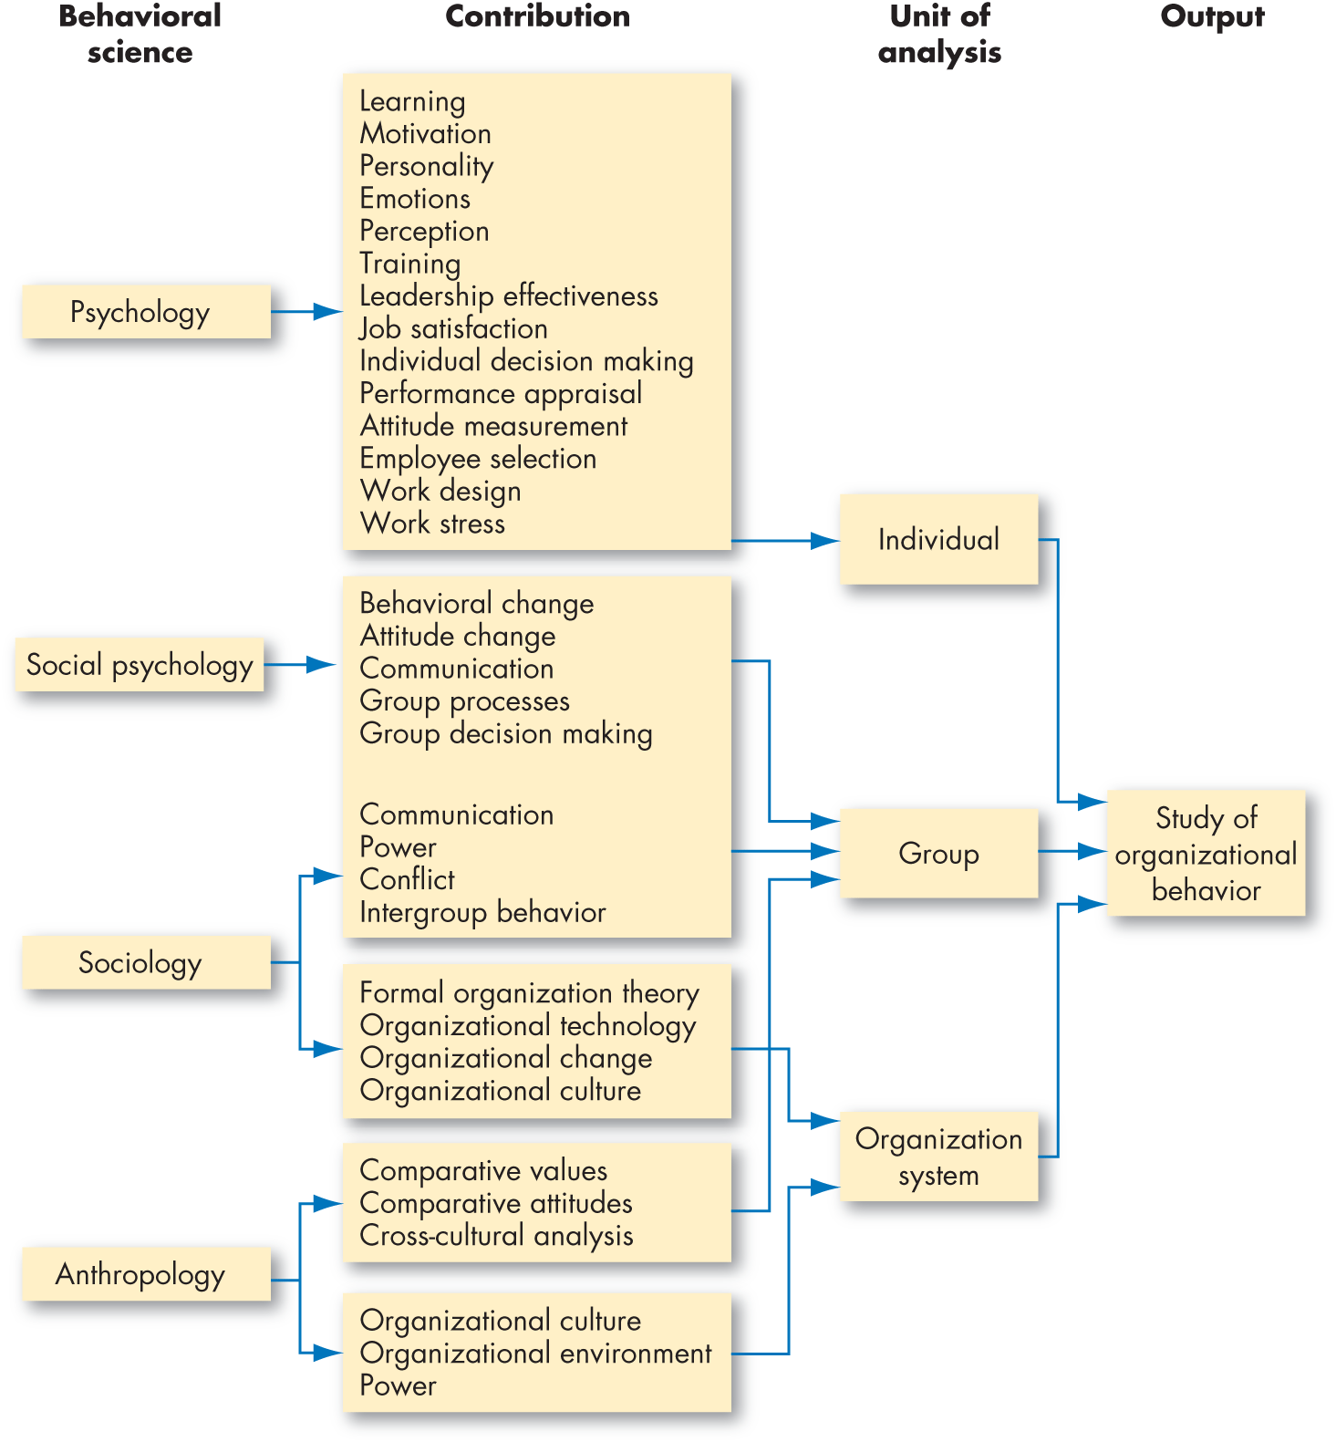

Slide 3
1) Psychology :
Study of behaviour of animals and humans.
Psychological experiment
Concerned with individual behaviour( Intrapeesoanl)
study of attitude, personality perception etc
Professional Psychologists( education, industry, business)
2) Sociology :
study of group behaviour
Behaviour of people in relation to their fellow beings
Interpersonal
Group dynamics, conflicts, c/m.

Slide 4
3) Social Psychology:
Both
Influence of people on one another.
Area → change
4) Anthropology:
Study of human race,its culture→significant influence
→ what people learn and how they behave
Org its own culture.
5) Political Science:
Study the behaviour of individual and groups within s political environment.
Conflict resolution, group coali tion, allocation of power and how people manipulate power in their self-interest.

Slide 5
6) Engineering:
Industrial engineering
Concerned with→ work measurement
productivity measurement
workflow analysis and design
labour relations
--→ Scope of OB:
Study of human behavior(individual,group,org)
Intrapersonal Interpersonal

Slide 6
Contextual perceptive of OB
OB
Productive approach
Contingency approach
System approach
HR approach
Interactionalism
approach

Slide 7
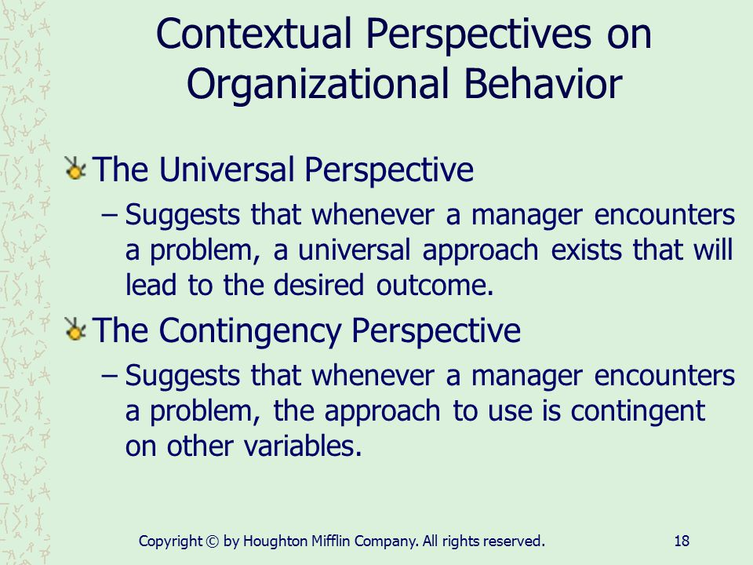
1)Human Resource Approach:
People are the central resource in any org
Lead to success of the org.
Supportive approach
Manager-from control to support
2) Contingency Approach:
Assumes that “ there is no one best way “ available in any org.
Most of the org services and outcomes are contingent or influenced by other variables

Slide 8
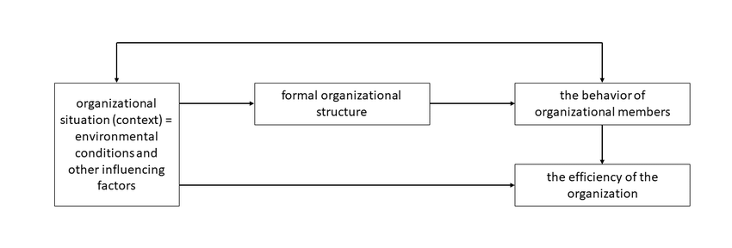
Org prob or situation determine
The one best way of responding
Org prob or situation must be evaluated in terms of……..
Elements of the situation, which then suggest
Contingent ways of responding
Fig: Universal approach Vs Contingency approach

Slide 9
3)System Approach:
The systems approach to OB views the organisation as a united, purposeful system composed of interrelated parts.
This approach gives managers a way of looking at the organisation in totality: as a whole person, whole group and social system.
In doing so, the systems approach tells us that the activity of any segment of an organisation affects, in varying degrees, the activity of every other segment.
According to this approach,
an organisational system receives four kinds of inputs from its environment: material, human, financial, and informational.
The organisation converts these inputs into products or services, employee behaviour, profits or losses, and additional information and supplies these to the environment. The system then receives feedback from the environment regarding the outputs
Thus, the organisation becomes an input-transformationoutput system. Organisation Inputs Human Material Financial Information Imports from the Environment Exports to the Environment Outputs Products/Services Profits/Losses Employee Behaviour Additional Information Feedback.

Slide 10
organisation
INPUTS
Human
Material
Financial
Information
OUTPUTS
Product/Services
Profits/Losses
Employee behaviour
Additioanl Behaviour
Receipt of orders
Order fulfilment
Imports from the environment
Exports to the environment
Products
feedback
Fig: Systems approach to org:

Slide 11
Productivity Approach:
Productivity, which is the ratio of output to input, is a measure of an organisation’s effectiveness.
It also reveals the manager’s efficiency in optimising resource utilisation.
The higher the numerical value of this ratio, the greater the efficiency.
Productivity is generally measured in terms of economic inputs and outputs, but human and social inputs and outputs are also important.
For example, if better OB can improve job satisfaction, a human output or benefit occurs. In the same manner, when employee development programmes lead to a by-product of better citizens in a community, a valuable social output occurs.
OB decisions typically involve human, social, and/or economic issues, and so productivity, usually a significant part of these decisions, is recognised and discussed extensively in the literature on OB.

Slide 12
Interactionalism:
Interactionalism is a relatively new approach to understanding behaviour in organisational settings.
First presented in terms of interactional psychology, this view assumes that individual behaviour results from a continuous and multidirectional interaction between characteristics of the person and of the situation.
More specifically, interactionalism attempts to explain how people select, interpret, and change various situations.
Fig. Below illustrates this perspective. It should be noted that the individual and the situation are presumed to interact continuously. This interaction is what determines an individual’s behaviour.
Individual
Behaviour
Situation

Slide 13
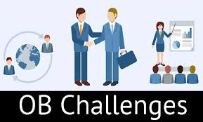

Slide 14
OB considers that organizations are made up of levels, moving up from the individual, to the group, to the entire organizational structure.
Each level contributes to the variety of activities that occur in today’s workplace.
The three basic levels are like building blocks:
Each level is constructed upon the previous level.
Group concepts grow out of the foundation we lay out in the section on individual behaviour.
We then overlay structural constraints on the individual and group in order to arrive at OB.
When we look at the different levels in the organization, we recognize that each has challenges that can affect how the levels above and/or below might operate.

Slide 15
At the individual level, managers and employees need to learn how to work with people who may be different from themselves in a variety of dimensions,
including personality, perception, values, and attitudes.
Individuals also have different levels of job satisfaction and motivation, and these affect how managers manage employees.
More organizations expect employees to be empowered and to take on more responsibility than ever before.
Perhaps the greatest challenge facing individuals (and organizations) is how to behave ethically.

Slide 16
Individual Differences People enter groups and organizations with certain characteristics that influence their behaviour, the more obvious of these being personality characteristics, perception, values, and attitudes.
Job Satisfaction: Employees are increasingly demanding satisfying jobs.
The belief that satisfied employees are more productive than dissatisfied employees has been a basic assumption among managers for years.
Motivation Many employees do not feel they receive fair or reasonable rewards for the work that they do.

Slide 17
Empowerment means managers are putting employees in charge of what they do.
In the process, managers are learning how to give up control, and employees are learning how to take responsibility for their work and make appropriate decisions.
The roles for both managers and employees are changing, often without much guidance on how to perform these new roles

Slide 18
Challenges at the Group Level
The behaviour of people in groups is more than the sum total of all the individuals acting in their own way.
People’s behaviour when they are in a group differs from their behaviour when they are alone.
Therefore, the next step in developing an understanding of OB is the study of group behaviour.
Working With Others Much of the success in any job involves developing good interpersonal, or “people,” skills.
Positive attitudes and behaviours and an ability to take responsibility for one’s actions are also key skills.
workforce diversity The mix of people in organizations in terms of gender, race, ethnicity, disability, sexual orientation, and age, and demographic characteristics such as education and socio-economic status.

Slide 19
Challenges at the Organizational Level
OB becomes more complex when we move to the organizational level of analysis.
organizations are not the sum total of individuals and groups. There are many more interacting factors that place constraints on individual and group behaviour.
change has become a key issue for organizations.
The need to develop effective employees, and to manage human resource issues such as absenteeism and turnover, is critical.
Meanwhile, Many companies have expanded their operations overseas, which means they have to learn how to manage people from different cultures.
Productivity implies a concern for both effectiveness (achieving goals) and efficiency (watching costs).

Slide 20
effectiveness is “doing the right thing,” while efficiency is “doing things right.
For example, a hospital is effective when it successfully meets the needs of its patients. It is efficient when it can do so at a low cost.
Developing Effective Employees One of the major challenges facing organizations in the twenty-first century is how to engage employees effectively so that they are committed to the organization.
We use the term organizational citizenship behaviour (OCB) to describe discretionary behaviour that is not part of an employee’s formal job requirements, but that nevertheless promotes the effective functioning of the organization.
“Put people first” in considering organizational objectives and suggests the people-first strategy not only generates a committed workforce, but also significantly affects the bottom line.
Global competition: To survive, they have had to reduce costs, increase productivity, and improve quality.

